Slide 1
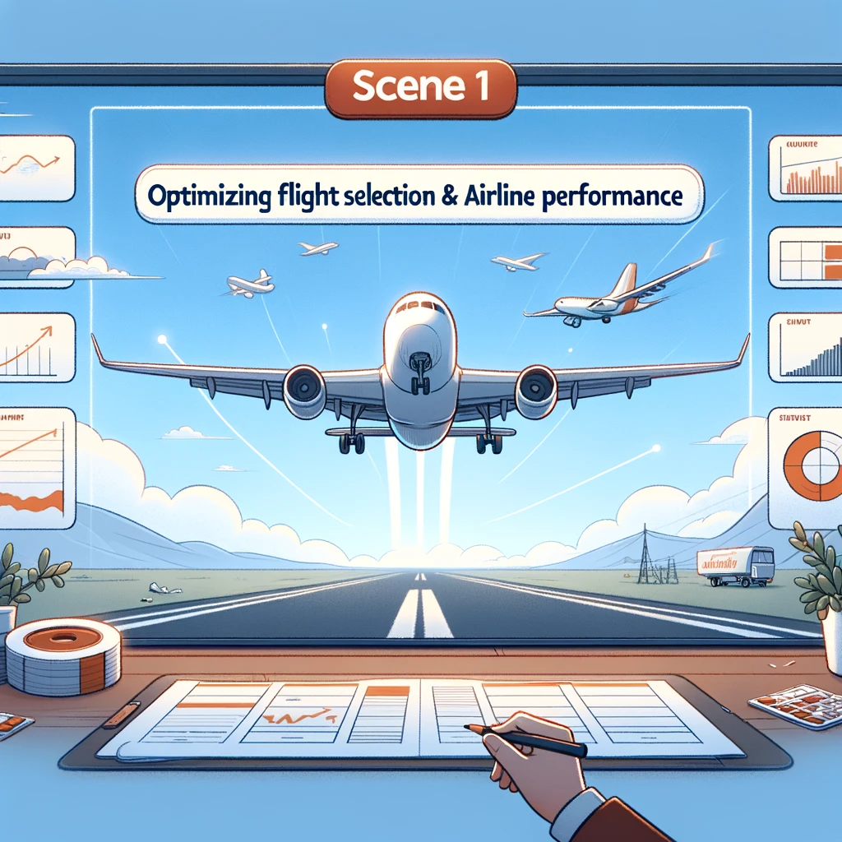

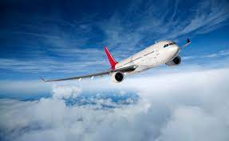
Optimization of Flight Selection & Airline Performance Analysis
Team Basic Economy
Created by:
David Allen, Jacob Waymire, Marcus Boswell, Pravin Dikshit

Slide 2
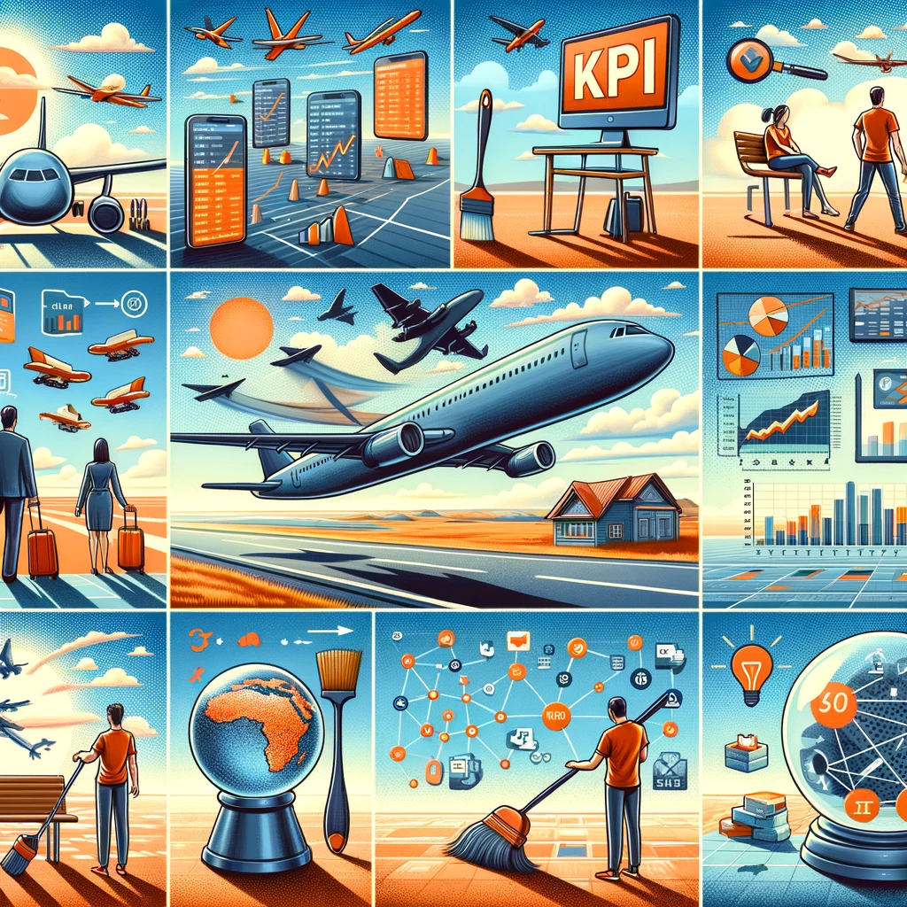
Agenda
Problem Description
Understand the problem
Key Performance Indicators
Data Cleaning
Clean and Structure the Data
Data Analysis and Visualization
Analyze the Data
Results
Optimization Model
Model Formulation and Results
Future Exploration
Collect
Report

Slide 3
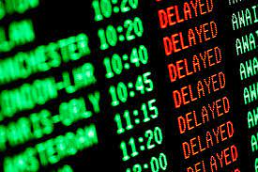
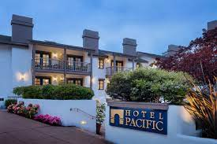
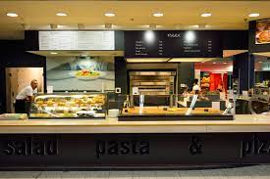
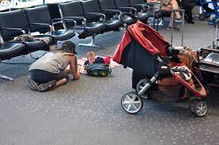
Problem Description
What determines the price of a Flight?
Understanding Customer Concerns
Complexity in Airline Pricing Systems
Lack of transparency for customers
Revenue optimization vs. customer experience
Hidden Costs of Commercial Flights:
Delays and cancellations
Additional baggage charges
Maintenance and operational issues
Descriptive Analysis: U.S. Airlines (2009-2019):
Insights into industry practices over a decade
Implications for passenger satisfaction and choices

Slide 4
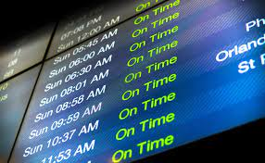
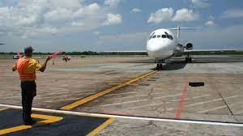
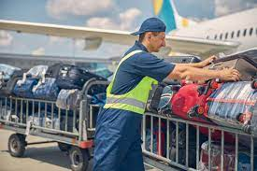
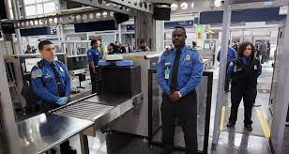
Problem Description
Key Performance Indicators:
Are measurable values that demonstrate how effectively an airline is achieving its operational and financial objectives.
Industry KPI’s:
On Time Performance
Baggage Handling
Safety Incidents
Revenue
Load Factor
Flight Utilization
Maintenance Status
Project KPI’s:
Flight Delays
Baggage Loss
Net income
Passenger-Employee Ratio

Slide 5
Tools & Techniques Used
Data Curation:
Chunking: Break down large datasets into manageable pieces.
Google Search APIs: Use these for programmatically accessing search results.
Web Scraping: Collect data from websites.
Regex to create data
Data Cleaning:
Standardize File Format: Convert data into a common format like CSV.
Standardize Data Structure: Ensure data is consistently structured for analysis.
Data Analysis and Visualization:
Pandas_UI/Pandas_GUI: Utilize these tools for an interactive interface to manipulate data with pandas.
Seaborn/Plotly: Create statistical graphics and interactive visualizations.
Optimization Model:
Model Formulation: Define the mathematical model for optimization.
Results: Analyze the output of the model to inform decisions.

Slide 6
Data Cleaning
Baggage
Revenue per
mile
Delays
2023
Airline Data:
There is a lot of data. (flights, maintenance, and safety)
50,000 parameters used just to keep the aircraft flying
8 terabytes of information per flight
Reporting systems are fairly-well calibrated so we did not have a high incidence of null values except where the airline closed or did not exist yet.
Most of our work was done in changing datatypes, grouping data, and matching data values between data frames.
Employee Pay
COVID-19
2019
2009
Financial Crisis
1995

Slide 7
Data Cleaning
Airline Data:
There is a lot of data. (flights, maintenance, and safety)
50,000 parameters used just to keep the aircraft flying
8 terabytes of information per flight
Reporting systems are fairly-well calibrated so we did not have a high incidence of null values except where the airline closed or did not exist yet.
Most of our work was done in changing datatypes, grouping data, and matching data values between data frames.

Slide 8
Data Cleaning
Quality Assurance:
Involves validating the accuracy and integrity of the data to ensure reliable and meaningful analysis results.
Data Exploration:
Refers to the initial examination of the dataset to understand its structure, patterns, and potential insights.
Datasets Used: 6
Datasets Unused: 7
Largest Dataset: 11.5 GB CSV, 200 million rows
Data Sources:
Bureau of Transportation Statistics Department
IBM (AI Training Set)
MIT (Global Airline Industry Program)
Transportation.gov
Data Used:
Delay Data
Mishandled Baggage
Passenger/Employee Ratio
Employee Pay
Revenue per mile

Slide 9
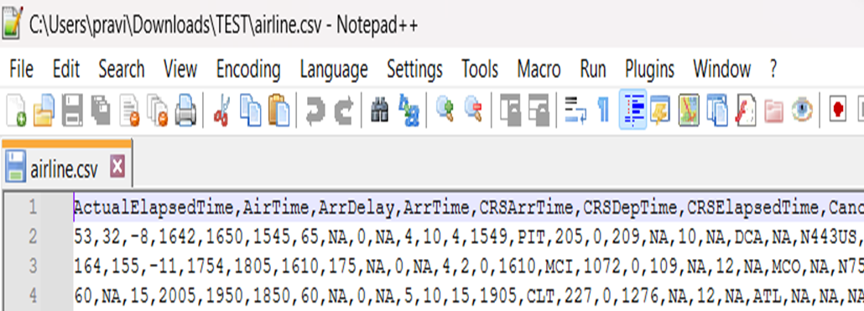
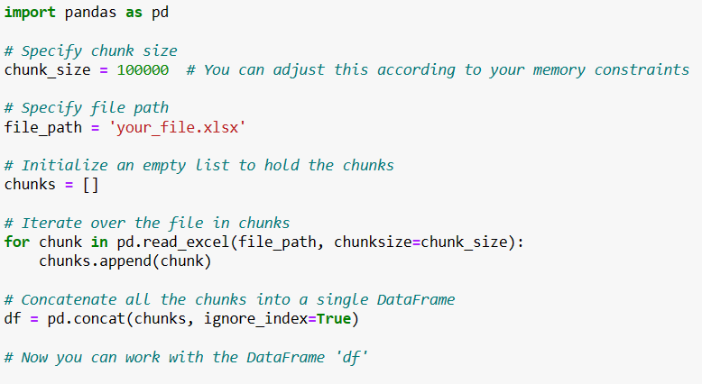
Data Cleaning
Notepad ++:
Read file and check header row, and check file integrity
Data Exploration:
Modify python code to adjust
Chunk size based on file size and RAM
Data Cleaning
Clean large data files and save as multiple small files

Slide 10
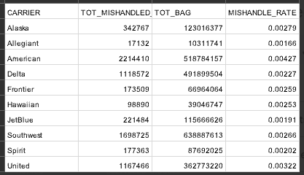
Data Cleaning
Wages Data
14 Airlines
6 Categories
For years 1995 to 2020
Missing values and erroneous entries
Manual cleaning of excel files
Average change per year, outliers (1)
Interpolation (2)
References
Baggage Data
Numerous Airlines
8 Categories
For years 2016 to 2021
Inconsistent format & small samples
Clean in python
Decisions on what to keep
Transform data if recoverable (3)
(1)
(2)
(3)

Slide 11

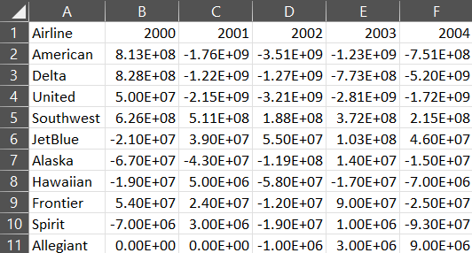
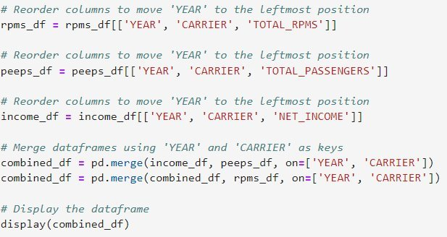
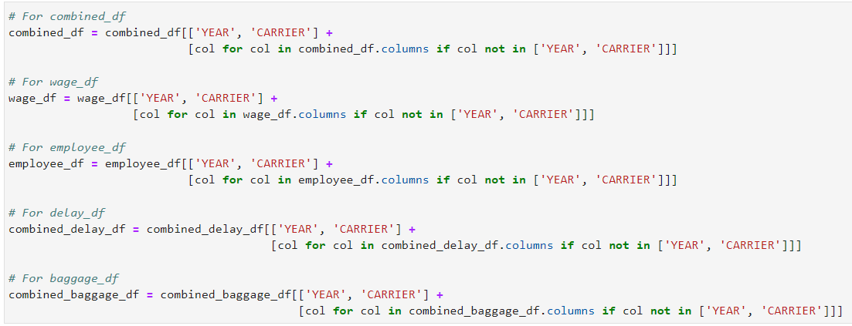
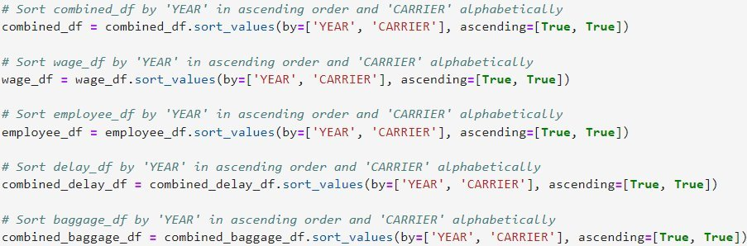
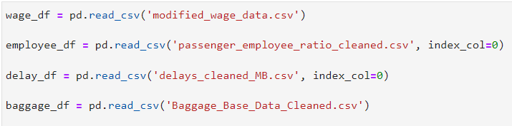
Data Cleaning
Consolidate and Standardize CSV Files
Rearrange Columns
Standardize Order of Information

Slide 12
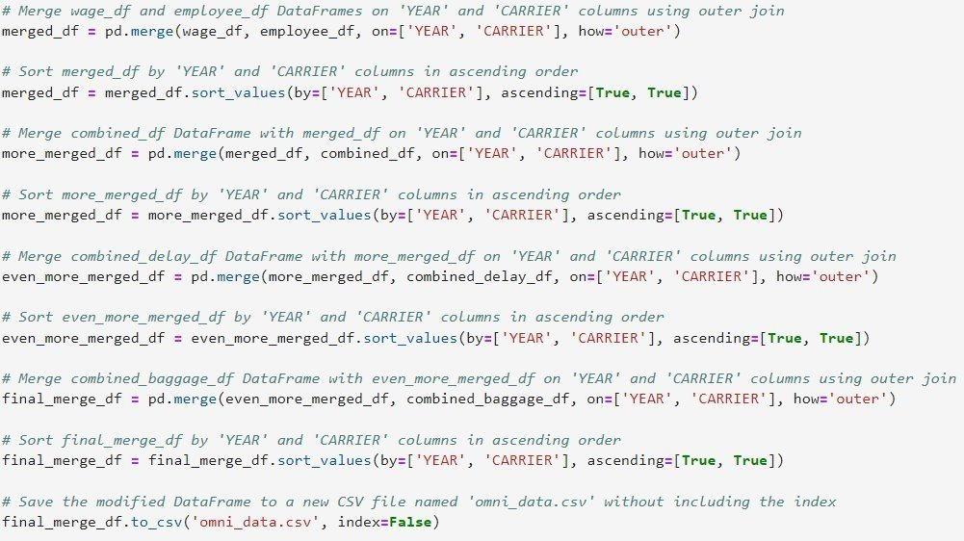
Data Cleaning
Begin Merging
Merge (A lot)
Save New Dataframe as a CSV

Slide 13
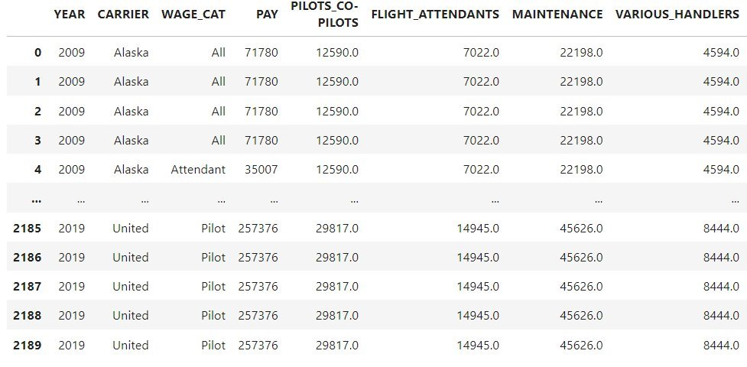
Data Cleaning
final_merge_df Information:
Class: 'pandas.core.frame.DataFrame'>
Data Rows: 2190
Data columns: 46
Datatypes: float64(40), int64(3), object(3)
Memory Usage: 804.1+ KB

Slide 14
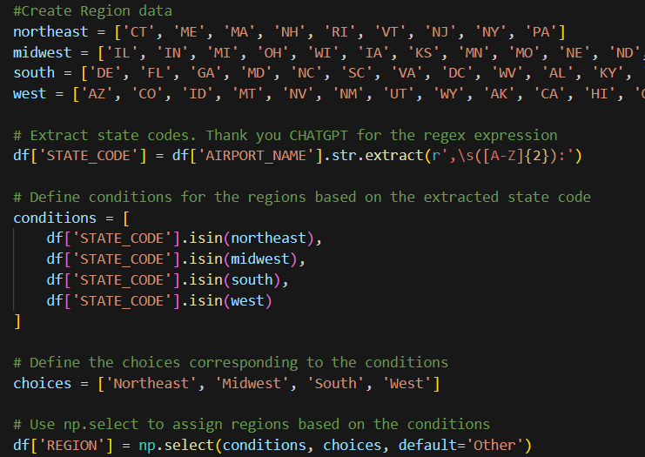
Data Cleaning
Joining Data:
Successfully merged all data sets into a single dataframe
Data Creation:
Created additional columns for ‘Regional’ Data
Transforming data:
Most of the data we had was aggregated data at smaller intervals then we wanted
Transforming the data from monthly data to an aggregated yearly data had to be done

Slide 15
Data Cleaning

Slide 16
Assumptions
Flight Delays
A difference between ULCC, Hybrid, and Network carriers
Net Income
The higher the airline rate or length of delays would correlate with a lower net income.
Passenger-Employee Ratio
Higher passengers per employee will negatively affect airline performance with baggage handling and delays

Slide 17
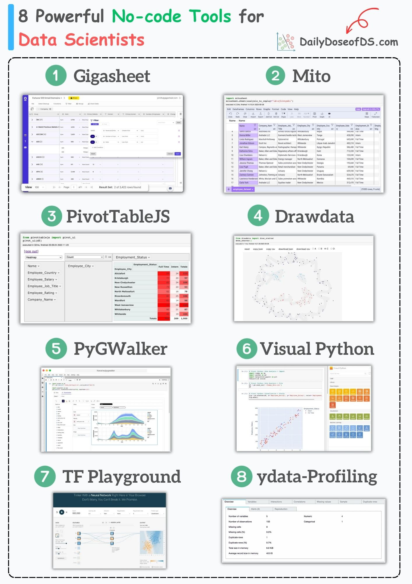
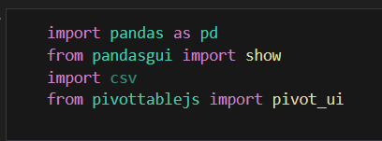
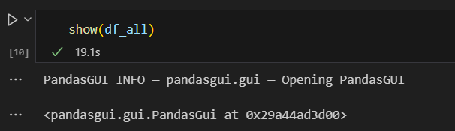
Data Analysis
Visualize data
Two GUI’s to help quickly explore and visualize data
Panda_UI
Pandas_GUI

Slide 18
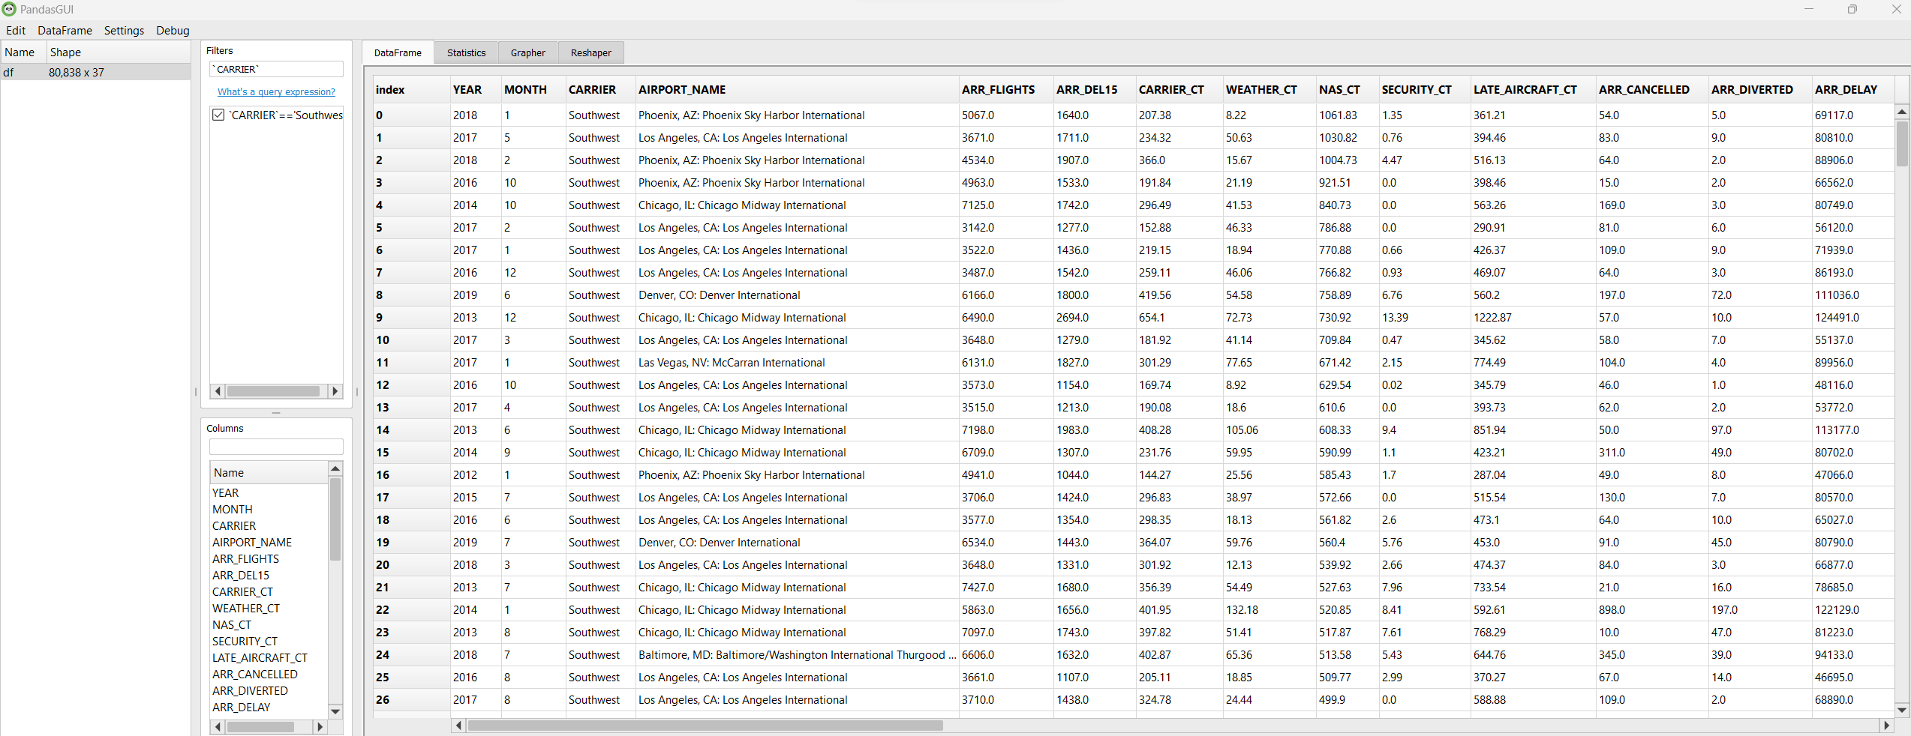
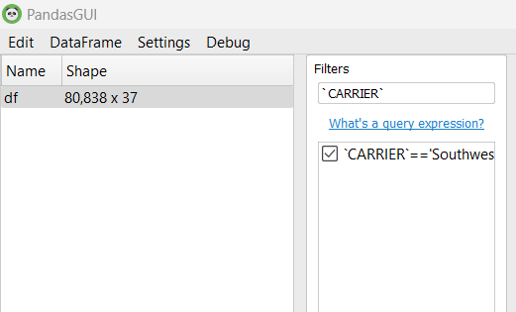
Data Analysis
Visualize data

Slide 19
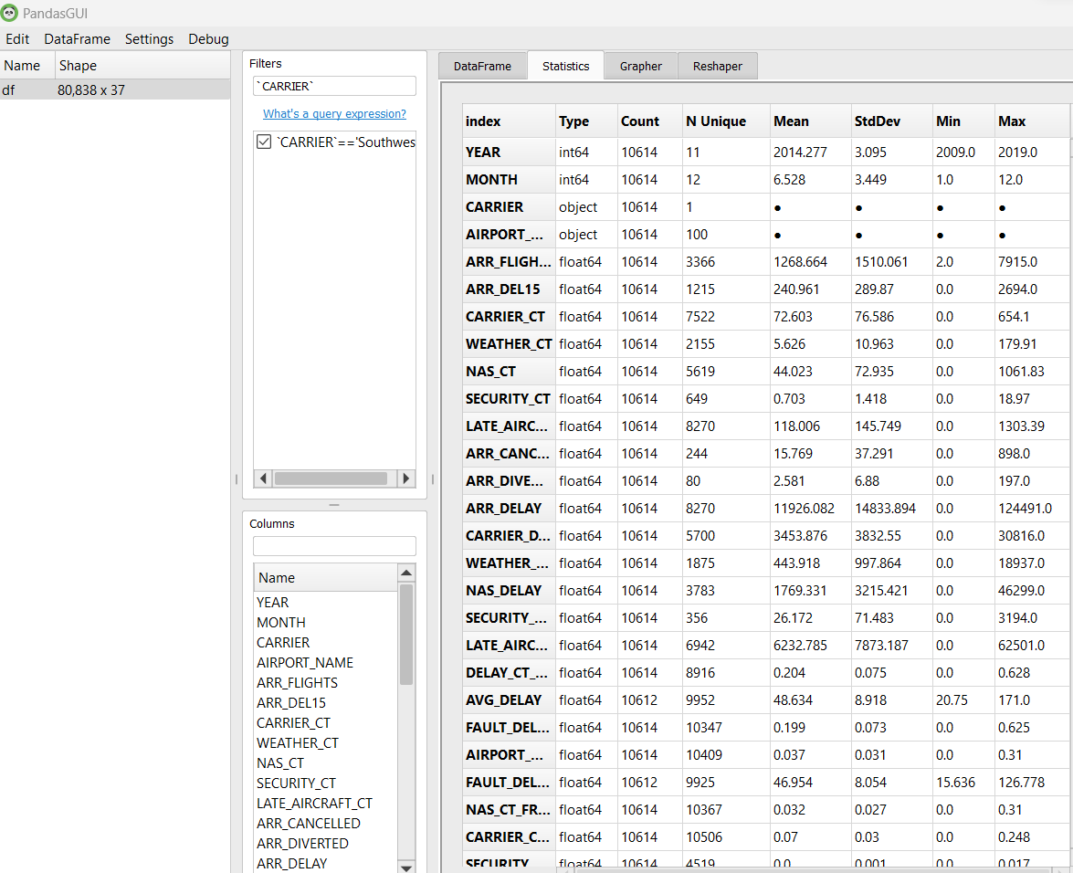
Data Analysis
Visualize data

Slide 20
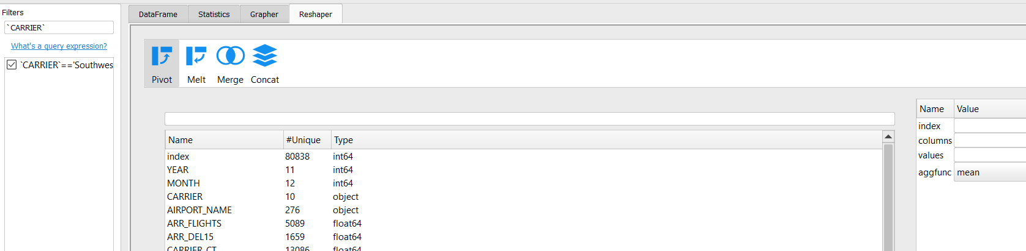
Data Analysis
Visualize data

Slide 21
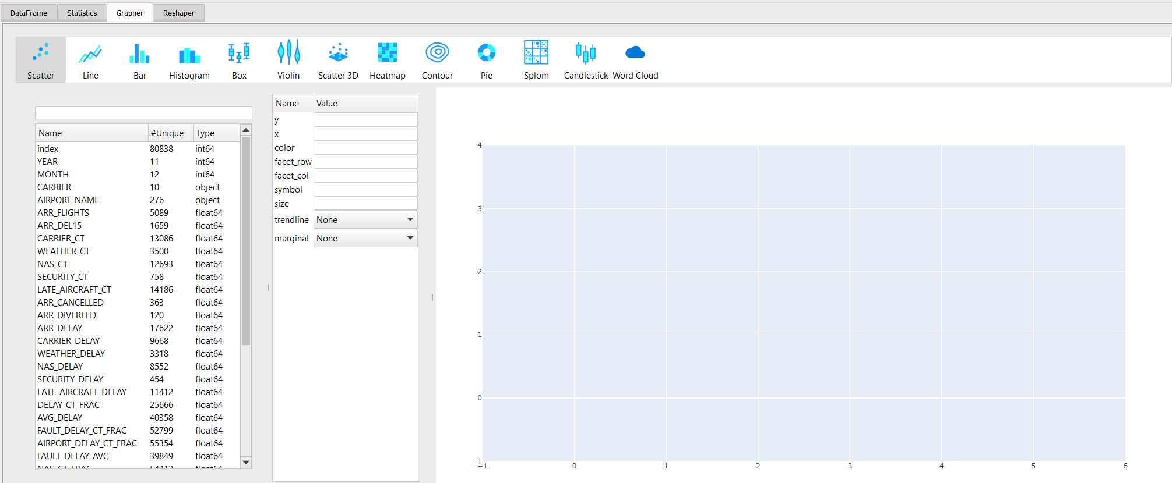
Data Analysis
Visualize data

Slide 22
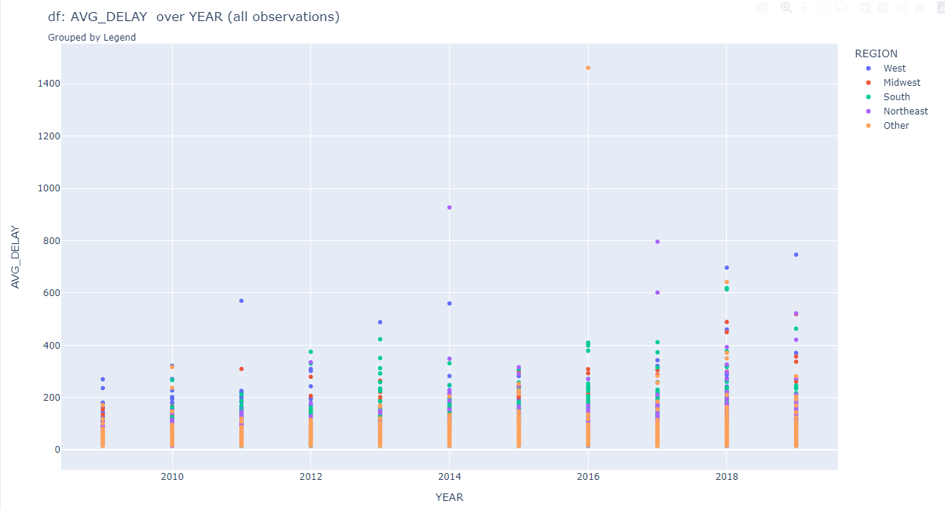

Data Analysis
Visualize data

Slide 23
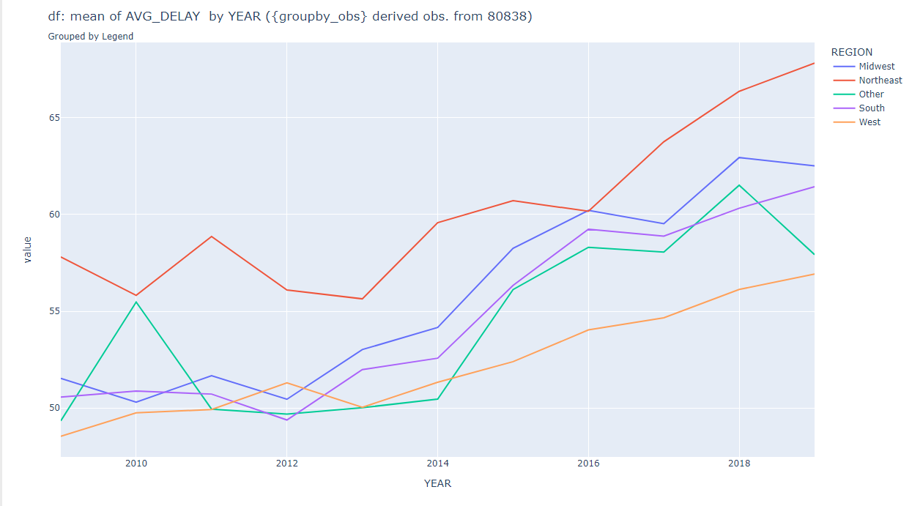

Data Analysis
Visualize data

Slide 24
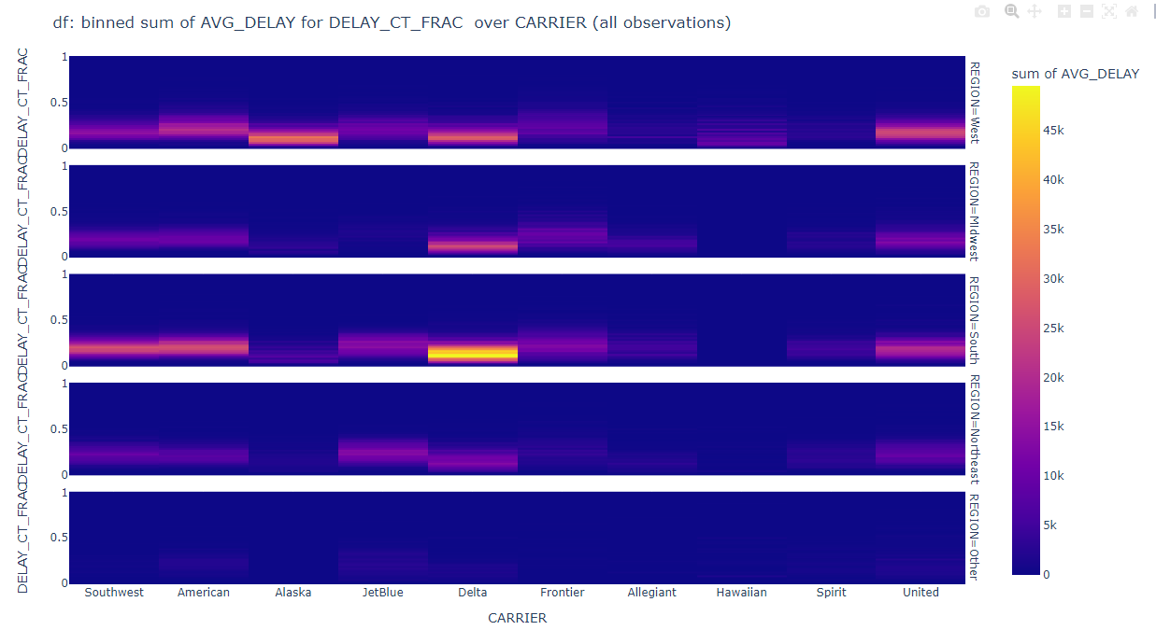

Data Analysis
Visualize data

Slide 25
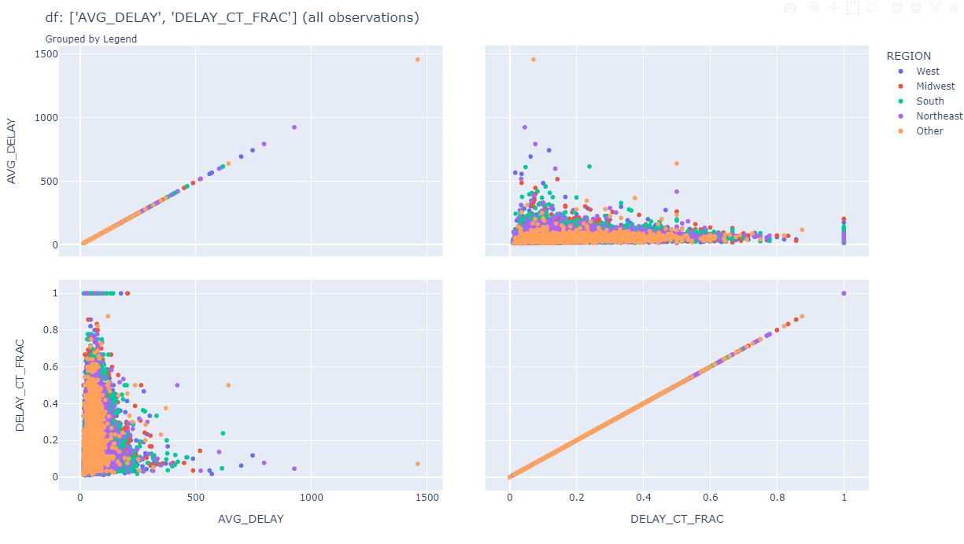

Data Analysis
Visualize data

Slide 26
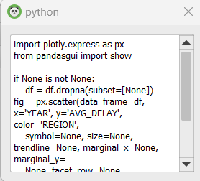
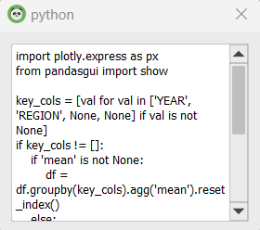
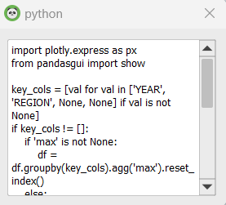
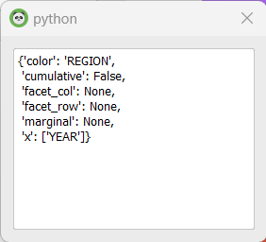


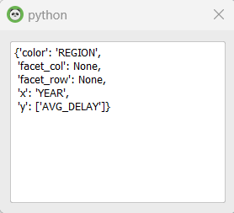
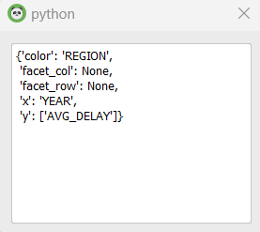
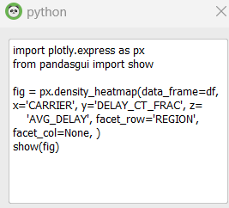
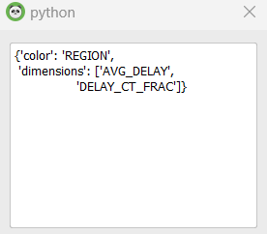


Data Analysis
Visualize data

Slide 27
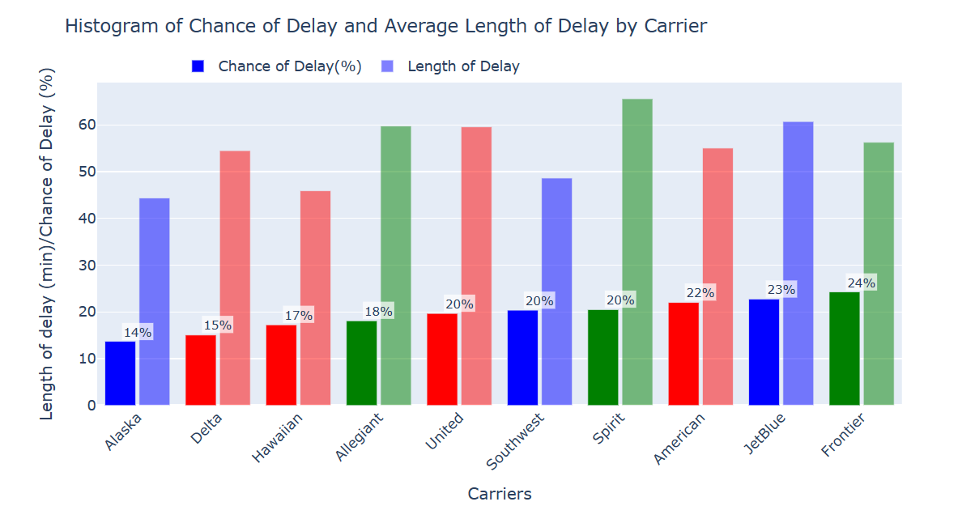
Data Visualization
Hybrid
Hub Spoke
Ultra Low Cost
Notes:
Add an additional column for fraction of delays. (delay_Ct_frac column)
Reorder from lowest to highest for expected cost- the big takeaway

Slide 28
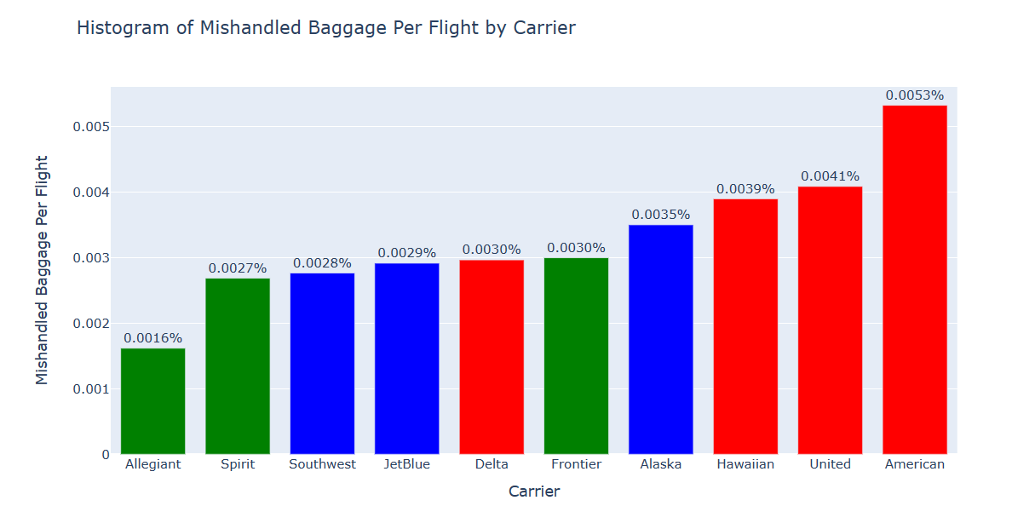
Data Visualization
Hybrid
Hub Spoke
Ultra Low Cost

Slide 29
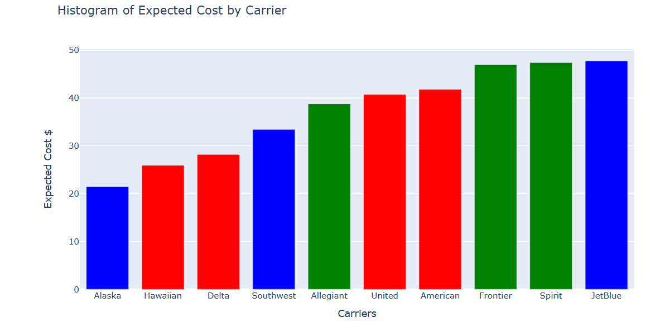
Data Visualization
Hybrid
Hub Spoke
Ultra Low Cost

Slide 30
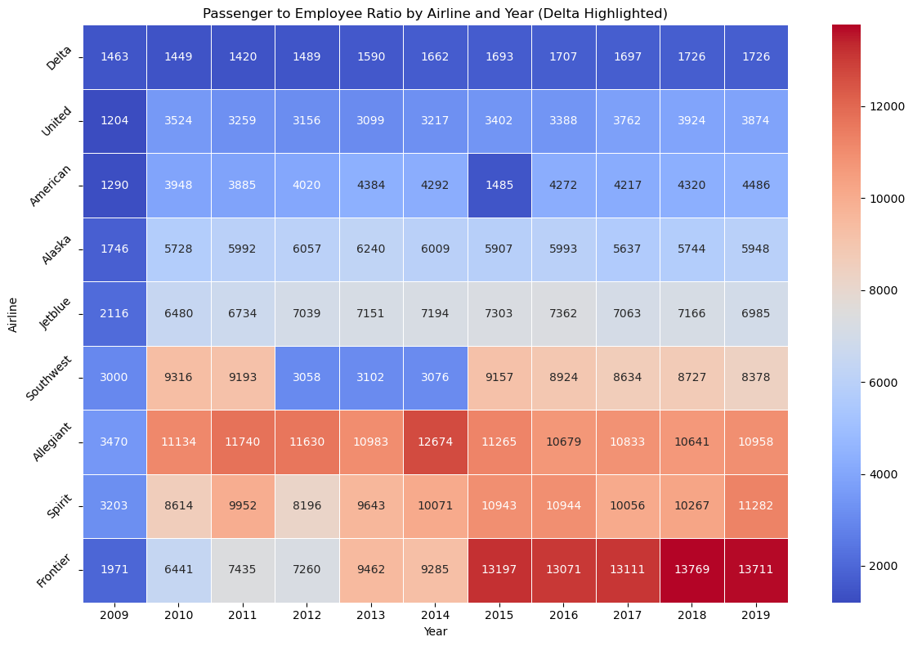
Data Visualization

Slide 31
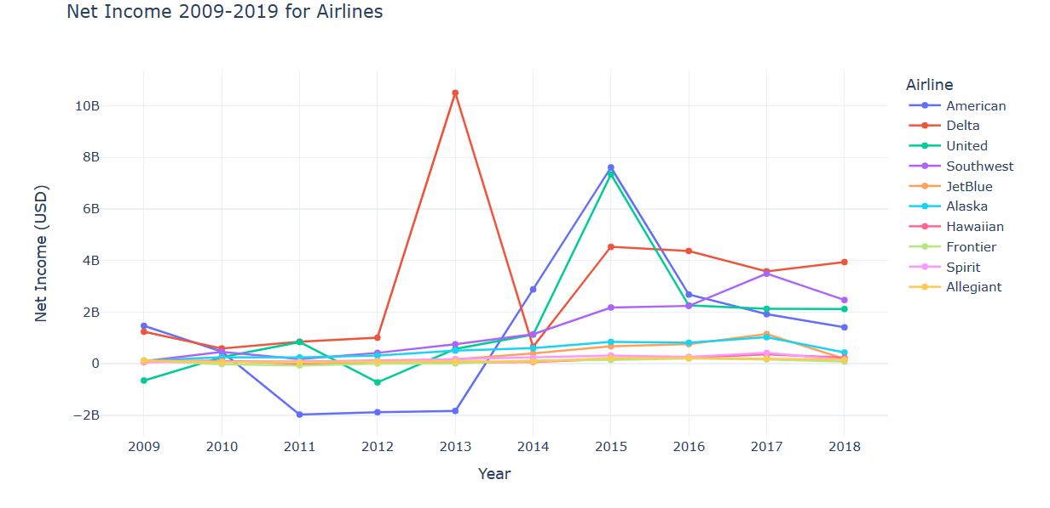
Data Visualization
Notes:
Individual slide for each graph
Reorder highest to lowest for bar graphs
Identify lows and highs

Slide 32
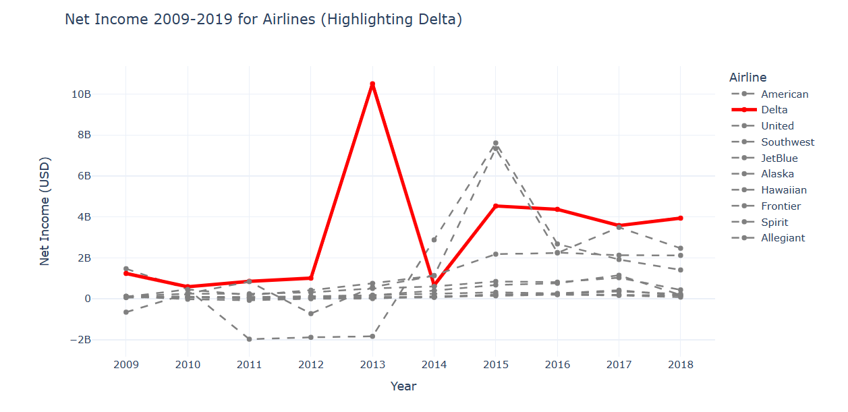
Data Visualization

Slide 33
Analysis Results
Operational Efficiency: Airlines like Delta, Alaska and Allegiant show better performance in managing delays and baggage handling, suggesting operational efficiency.
Financial Health: Delta appears to have a significantly higher average net income, indicating strong financial health. In contrast, American and United have negative averages, suggesting financial challenges.
Employee Efficiency: Delta has a notably low passenger-employee ratio, suggesting high staffing levels relative to passengers, potentially indicating higher service levels or operational efficiency. Allegiant, Spirit and Frontier, with higher ratios, may operate with leaner staffing models.
Best Airlines: Considering both operational and financial metrics, Delta, Alaska and Allegiant stand out as strong performers across different aspects in their respective category.

Slide 34
Assumptions
Excel
DataFrame
JSON
Formats
Delay, Wages, Baggage, Revenue, Price, Distance,
Layover, Employee Ratios
Available Data
Problem Type
Feasible, Bound,
Mixed Integer
Goals
Minimize Cost
Gain Insights

Slide 35




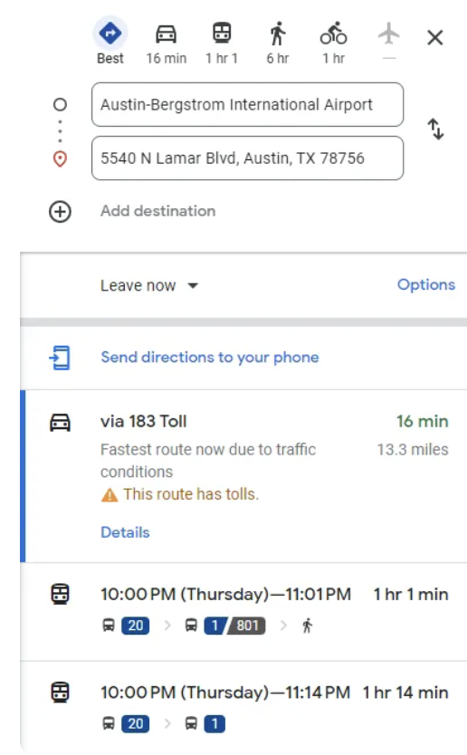
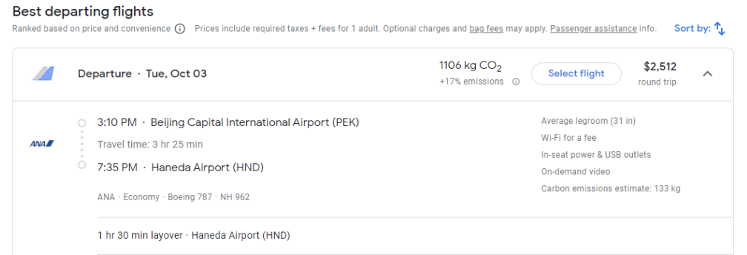

Web Scraping
Step 2: Directions to Each Airport
Step 3: Flights for Every Airport
Step 1: Find Closest Airports

Slide 36







Web Scraping
New Packages
Output Structures
Optimization Inputs
Limited Queries
IATA Codes
Iterative Design
Iterative Software Design. https://www.geeksforgeeks.org

Slide 37




Model Formulation
Concept
Version 1
Version 2

Slide 38



Model Formulation
Index Notation
Objective Function & Constraints

Slide 39



Results
Eliminate Previous Solutions & Iterate
Solve Initial Problem
Model Insights:
Price is a strong indicator
Hidden costs are not linearly correlated with price (max ~38%, min ~8%)
# of Legs inverse relationship with price
Larger airports (or hubs) may have cheaper prices for the same flights

Slide 40
Future Exploration
Data Sources & Cleaning:
Acquire source delay data
Incorporate flight tracking data and social media sentiment
Implement automated cleaning tools
Visualization:
Integrate into a dashboard
Build UI for non-technical users
Allow custom report generation
Web Scraping:
Iterative function for combinations of:
Destination airports
1-Day shifts in timeline
Google hotels for lodging delays
Optimization Model:​
Run from command line / batch mode
Implement added web scraping
Additional metrics for hidden cost
Parking by airport per day
Layover costs (meals & WTP)
Costs for overnight flights (hotels)

